Slide 1
AUTOMOBILE MARKET ANALYSIS
NAME: GAAYATHRI PRIYAA K R
MENTOR: JAYA PANDEY

Slide 2
INTRODUCTION
PROJECT-1
The automotive market is shifting towards eco-consciousness, prioritizing fuel efficiency and safety.
Smith, a data analyst, will analyze a car dataset to identify potential models for launch.
He will also present insights on the most diverse car manufacturer in the given country.
PROJECT-2
In project 1, we analyzed the car dataset to identify potential models for launch and explored insights on the most diverse car manufacturer.
In this sprint, more business questions will be addressed to further analyze the most diverse manufacturer.
The analysis will focus on fuel efficiency and driving patterns to identify opportunities for reducing carbon emissions.

Slide 3
PROJECT OBJECTIVES
Clean the car dataset for analysis.
Identify key factors for new car model launches.
Benchmark manufacturers and analyze competitive diversity.
Analyze fuel efficiency to spot trends and reduce emissions.
Identify the most diverse car manufacturer in the country.
Provide actionable insights for product development and innovation.
Present findings on potential car models and fuel efficiency improvements.

Slide 4
PROJECT-1
Q1: Identify the top 10 cars with the highest miles per gallon and name the manufacturers.
Q2: Identify the top 10 cars with the highest miles per gallon based on displacement and name the manufacturers.
DISPLACEMENT | MAKE | MODEL
1197 | Suzuki | Ignis
1248 | Tata | Bolt
998 | Suzuki | Alto K10
1498 | Volkswagen | Polo
2179 | Mahindra | Tuv300 Plus
1497 | Tata | Altroz
1198 | Mahindra | Kuv100 Nxt
1199 | Tata | Tiago
1461 | Mahindra | Verito Vibe
999 | Renault | Kwid
INTERPRETATION:
These are the top 10 cars with the highest miles per gallon.
INTERPRETATION:
These are the top 10 cars with the highest miles per gallon based on displacement.

Slide 5
Q3: Identify the top 3 manufacturers with the highest no. of cars in the hatchback body type.
Q5: Present the relationship between
a) Displacement and mileage
b) Mileage and fuel tank capacity
INTERPRETATION:
The top 3 manufacturers with highest no. of hatchback body type are SUZUKI, HYUNDAI and TATA.

Slide 6
Q6: Identify the car which is best for adventurous drives.
Q7: A person choosing a family car may consider the following area for analysis:
Car size
Engine power
Safety features (Air bags, child safety locks)
Comfort during long distance travelling (seat material ,brake system, fuel tank capacity etc.)
Entertainment options (Bluetooth ,FM radio)
row | Max of Height_ | Max of Wheelbase | Max of Ground_Clearance | Max of Length_ | Max of Width_ | Max of Displacement | Max of Cylinders | Max of Number_of_Airbags
Bmw | 1805 | 2825 | 190 | 5219 | 2218 | 2487 | 4 | 10
3-Series | 1429 | 2688 | 155 | 4633 | 1811 | 1968 | 4 | 6
Row Labels | Max of Seating_Capacity | Max of City_Mileage_km_litre | Max of Number_of_Airbags | Max of Width_mm | Max of Height_mm | Max of Length_mm
Mahindra | 8 | 80 | 6 | 1960 | 1880 | 5118
INTERPRETATION:
By considering some features like car size, ground clearance, displacement , and few safety features we conclude that BMW – 3 Series is suitable for adventurous drives.
INTERPRETATION:
By considering come features we found that MAHINDRA is the car suitable for family usage.

Slide 7
Q8: Manufacturer has decided to launch two types of car
(i) Compact car for city usage
(ii) City for highway usage
Identify the potential competitor for the two types of cars.
(i) Compact car for city usage
Row Labels | Max of City_Mileage_km_litre | Max of Fuel_Tank_Capacity_litre | Max of Displacement | Max of Length_mm | Max of Width_mm | Max of Height_mm | Max of Seating_Capacity
Suzuki | 27.39 | 60 | 1248 | 3995 | 1745 | 1675 | 5
Hyundai | 24 | 60 | 1396 | 3995 | 1760 | 1560 | 5
(ii) City for highway usage
Row Labels | Max of Boot_Space_litre | Max of Number_of_Airbags | Max of Fuel_Tank_Capacity_litre | Max of Displacement | Max of Seating_Capacity | Max of Width_mm | Max of Height_mm | Max of City_Mileage_km_litre | Max of Length_mm
Bmw | 650 | 10 | 88 | 6592 | 7 | 2218 | 1805 | 18 | 5219

Slide 8
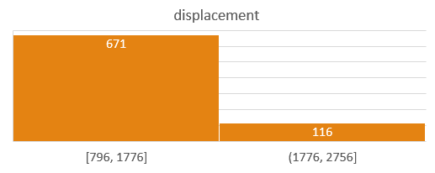
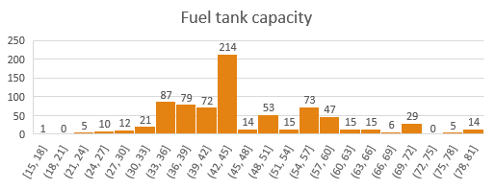
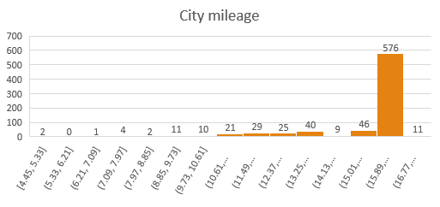
Q9: Identify the outliers from following columns using Histogram method.
(i) Displacement(Bin Size=980)
(iii) Fuel Tank Capacity(Bin Size=3)
(ii) City Mileage(miles/gallon)(Bin Size=0.88)
INTERPRETATION:
The outliers are identified using the IQR method and they are presented using histogram method.

Slide 9
Q10: Identify the top 3 manufacturers with the highest number of variants in the following categories:
(i) Hatchback
(iii) SUV
(ii) Sedan
INTERPRETATION:
The top 3 manufacturers with the highest number of variants in the hatchback , SUV and sedan category.

Slide 10
Q11: Find the most popular car body type.
Row Labels | Count of Body_Type
Hatchback | 263
SUV | 224
Sedan | 223
MUV | 32
MPV | 25
Crossover | 10
Coupe | 3
Sports, Convertible | 2
SUV, Crossover | 2
Crossover, SUV | 2
Sedan, Coupe | 1
Grand Total | 787
INTERPRETATION:
The most popular car body type among all the manufacturers and models are 1. HATCHBACK with the count of 263 2. SUV with the count of 224 3. SEDAN with the count of 223.

Slide 11
PROJECT-2
Q1: Identify the top 2 manufacturers who offer widest range of car variants.
INTERPRETATION:
The top 2 manufacturers who offer widest range of car variants are
1. Suzuki 2. Hyundai

Slide 12
Q2: Identify Calculate and compare variations btw city mileage data using different measures of dispersion for the following 3 manufacturers:
1) TATA 2) Suzuki 3) Hyundai
Q3: a) Display and check how city mileage depends on fuel tank capacity using scatter plot along with trendline.
 | TATA | MARUTI SUZUKI | HYUNDAI
MEAN | 17.71 | 18.99 | 16.50
VARIANCE | 12.47 | 18.57 | 4.09
SD | 3.53 | 4.31 | 2.02
COV | 20% | 23% | 12%
b) Display and check how displacement depends on fuel tank capacity using scatter plot along with trendline.
INTERPRETATION:
SUZUKI has the widest variation of city mileage since, it has the highest variance, SD, range, and cov.

Slide 13
Q5(B): (a) Plot avg speed & distances driven against fuel efficiency to identify trends.
(b) Use scatterplots & correlation matrices to explore relationships btw fuel efficiency & other variables.

Slide 14
Summary and Observations
Sprint 6 (Tasks 1-3):
- The focus was on identifying the top car manufacturers and their models based on factors like city mileage, displacement, and body type (hatchback, MPV, sedan, etc.).
- Mahindra and Suzuki were recognized as top-performing manufacturers, consistently appearing in the top 10 lists based on these key factors.
- Scatter plots were used to examine the relationships between various car features and capacities across manufacturers.
- Hyundai was identified as a manufacturer with a significant number of outliers, which is a concerning observation.
Sprint 6 (Tasks 4-5):
- These tasks involved analyzing the relationships between different car features to identify models suited for specific purposes, such as adventure, family use, or compact city cars.
- BMW (X4) was identified as ideal for adventurous rides, Mahindra cars for family usage, and Tata (Nano Genx) for compact city usage.
- The analysis also compared cars based on customer preferences and competitor models, suggesting that manufacturers need to improve features where competitors excel. For example, Tata Nano Genx competes with Suzuki Alto 800 Tour in compact cars, while Tata Nano Genx and Suzuki Celerio X compete in family cars.

Slide 15
Sprint 6 (Tasks 9-10):
- A histogram was created to compare data with and without outliers, highlighting the effect of outliers on data distribution.
- The top three manufacturers by body type were:
- Hatchback: Suzuki, Hyundai, and Tata
- Sedan: Hyundai, Skoda, and Toyota
- SUV: Mahindra, Tata, and Hyundai
- The number of variants was also considered, identifying Suzuki, Hyundai, and Tata as leaders in hatchbacks, Hyundai and Skoda in sedans, and Mahindra and Tata in SUVs.
Sprint 7 (Project 2):
- This sprint focused on fuel efficiency and driving patterns to help reduce carbon emissions.
- The top two manufacturers with the widest range of car variants were Suzuki (163 variants) and Hyundai (130 variants).
- A clustered chart and pivot table were used to show the number of car variants under each body type for these manufacturers.

Slide 16
Key Observations
Mahindra and Suzuki are top performers in multiple categories.
Hyundai has issues with outliers that need attention.
BMW, Suzuki, and Tata are leading in specific niche markets, such as adventure, family, and city usage, respectively.
The competitive analysis suggests that manufacturers should focus on improving features where they lag behind their rivals.
Fuel efficiency and reducing carbon emissions are becoming critical factors in automotive analysis.
This sprint provided deeper insights into identifying diverse car models and manufacturers suitable for specific purposes while considering market competition and environmental impact.

Slide 17
Thank you

